Slide 1

Time Series forecasting- MA/Centered/Weighted MA Method
Dr. Jia Uddin
AI and Big Data Department
Endicott College, Woosong University
Daejeon, South Korea
Email: jia.Uddin@wsu.ac.kr

Slide 2
Time series data
Time series data is a sequence of observations collected from a process with equally spaced periods of time
Example:
Daily data on sales
Daily customers
Monthly interest rates, costs
Monthly unemployment rates
Daily closing prices of stock, etc..

Slide 3
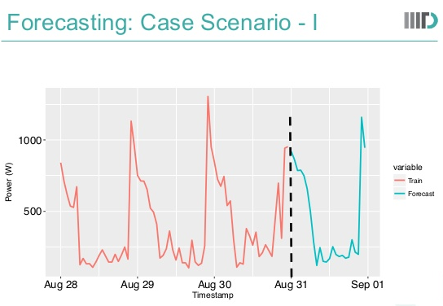
Forecasting
Time series forecasting: involve the prediction of future values of a variable based entirely on the past and present observation of that variable
Data collected at regular intervals of time
Example: Weather, electricity forecasting

Slide 4
Assumptions
Historical information is available
Past patterns will continue in future

Slide 5
How far can we predict
short-term( 1~2 periods)
Medium-term (5~10 periods)
Long-term (12+periods)
No line of demarcation

Slide 6
Forecasting steps
step 1: Problem definition (demand supply, fault detection, weather, etc.)
Step 2: Information gathering (Sense-smart meters, temperature, etc.)
Step 3: Preliminary analysis (visualizations-Tableau, R, Python, Matlab, excel, etc.)
Step 4: Choosing and fitting models
Step 5: Model evaluation
Notes:
https://www.youtube.com/watch?v=gj4L2isnOf8
http://web.pdx.edu/~gerbing/515/Resources/ts.pdf

Slide 7
Quantitative Forecasting methods
Moving averages
Naïve approach
Exponential Smoothing
Trend projection

Slide 8
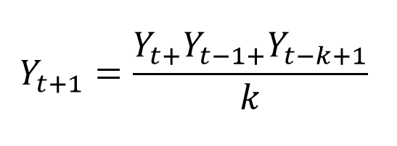
Moving Averages
No general method exists for determining K
K need to select based on empirical study
Notes:
https://www.youtube.com/watch?v=Wo5YWXDRXv8

Slide 9
Centered Moving Average
https://www.itl.nist.gov/div898/handbook/pmc/section4/pmc422.htm
https://otexts.com/fpp2/moving-averages.html

Slide 10
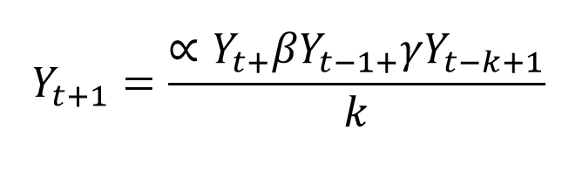
Weighted Moving Averages
No general method exists for determining K
K need to select based on empirical study
A Weighted Moving Average puts more weight on recent data and less on past data.

Slide 11
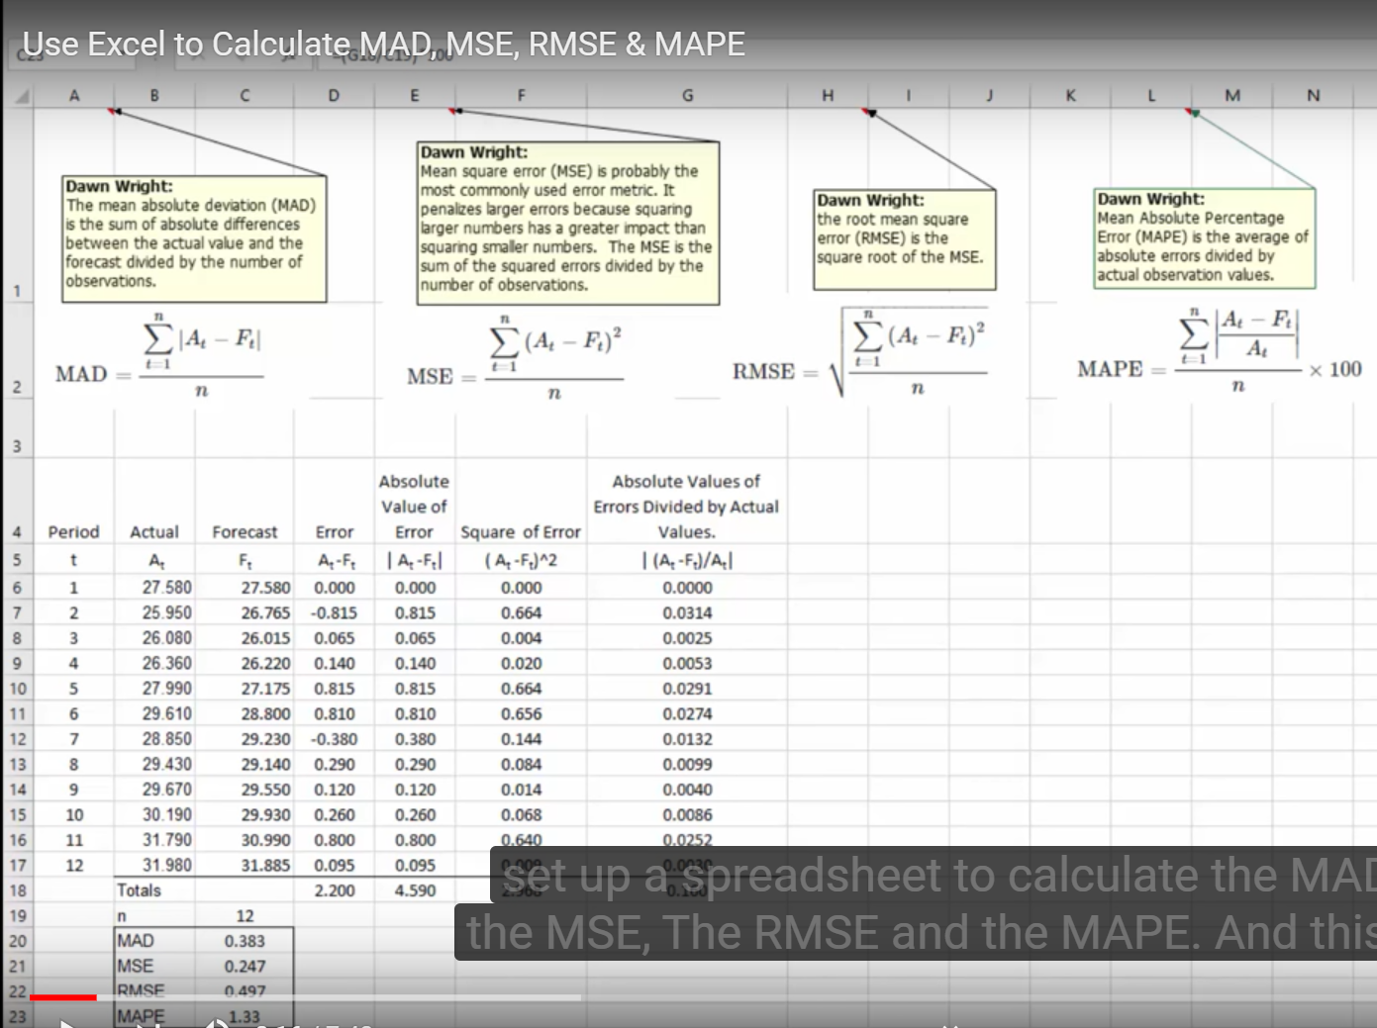
MAD, MSE, RMSE, MAPE
Mean Absolute Deviation (MAD) the Mean Square Error (MSE), The Root Mean Square Error (RMSE), and the Mean Absolute Percentage Error (MAPE)

Slide 12
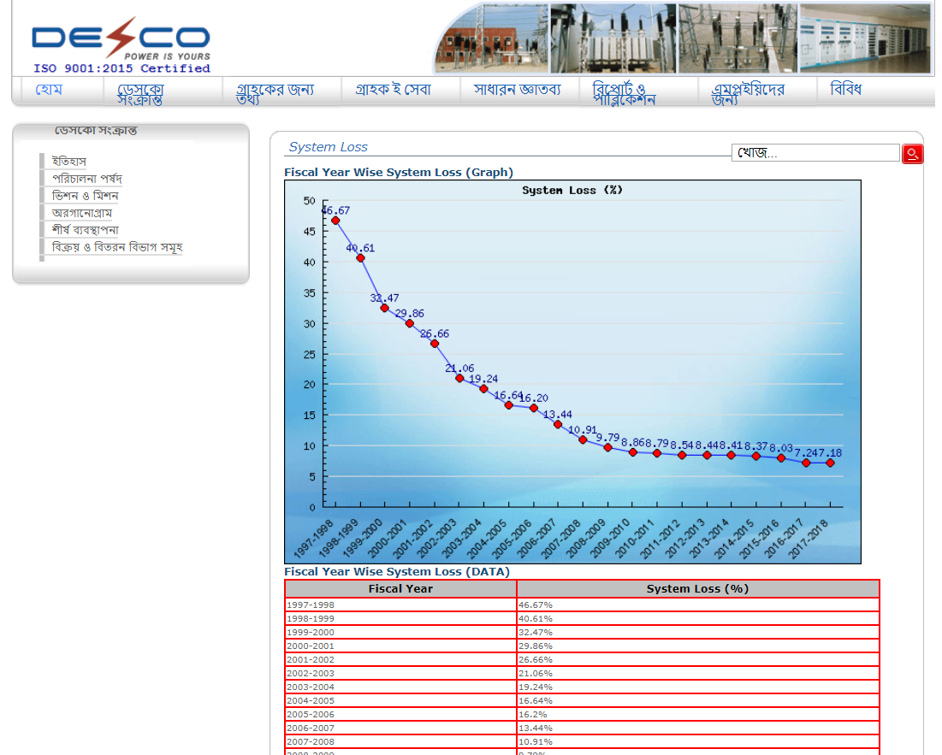
Data set
https://www.desco.org.bd/newsysadmin/sysloss_b.php
Notes:
https://www.desco.org.bd/newsysadmin/sysloss_b.php

Slide 13
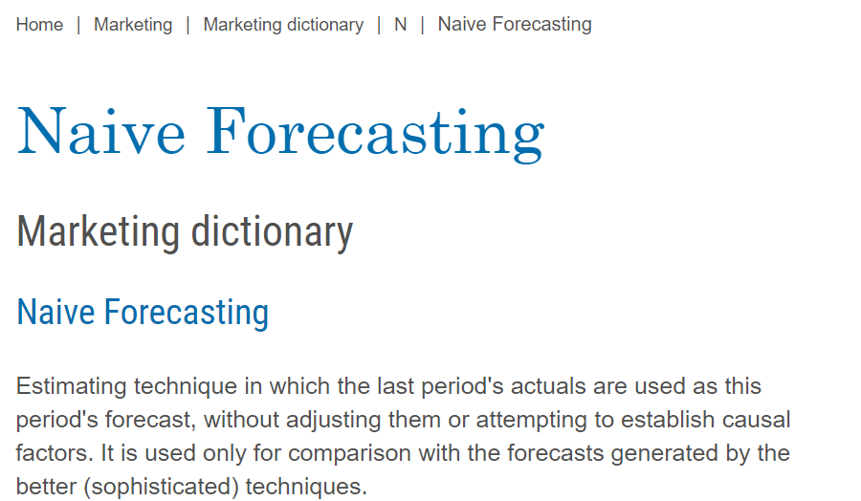
Data set
https://www.avercast.com/post/naive-forecasting
Notes:
https://www.monash.edu/business/marketing/marketing-dictionary/n/naive-forecasting

